Slide 1

Demo Day
01-06 August 2023
CAREER GUIDANCE FOR STUDENTS
S.NO | Name of the student | Roll No. | Branch
1 | A.Vardhan | 21951A04P1 | ECE
2. | M.Vardhan | 21951A04P2 | ECE

Slide 2
PROBLEM STATEMENT
Human face analysis constitutes one of the most important tasks in computer vision.
The characterization of age, gender, facial attributes, expressions, garment, and even personality, to cite but a few, are crucial in several applications, like user identiﬁcation, social interaction, face tracking, and behavior recognition.
Face analysis in images in the wild still pose a challenge for automatic age and gender recognition tasks, mainly due to their high variability in resolution, deformation, and occlusion.
Age and gender predictions of unfiltered faces classify unconstrained real-world facial images into predefined age and gender. Significant improvements have been made in this research area due to its usefulness in intelligent real-world applications.

Slide 3
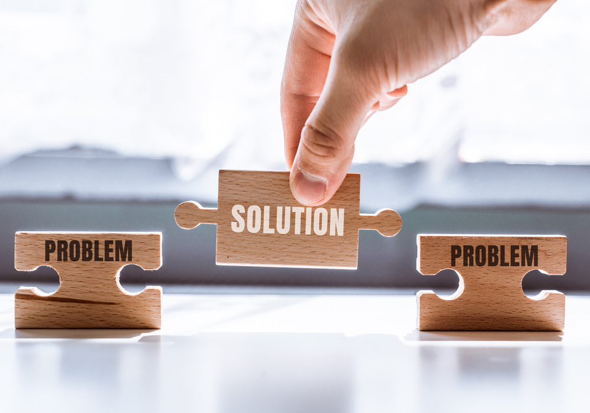
PROPOSED SOLUTION
Facial analysis has gained much recognition in the computer vision community.
Human’s face contains features that determine identity, age, gender, emotions, and the ethnicity of people.

Slide 4
PROPOSED SOLUTION
Among these features, age and gender classification can be especially helpful in several real-world applications including security and video surveillance, electronic customer relationship management, biometrics, electronic vending machines, human-computer interaction, entertainment, cosmetology, and forensic art.
The images in these categories have some variations in appearance, noise, pose, and lighting which may affect the ability of those manually designed computer vision methods to accurately classify the age and gender of the images.
We formulate the age and gender classifications task as a classification problem in which the CNN model learns to predict the age and gender from a face image.

Slide 5
PROOF OF CONCEPT/PROTOTYPE DETAILS
opencv_face_detector.pbtxt
opencv_face_detector_uint8.pb
age_deploy.prototxt
age_net.caffemodel
gender_deploy.prototxt
gender_net.caffemodel
For face detection, we have a .pb file- this is a protobuf file (protocol buffer); it holds the graph definition and the trained weights of the model. We can use this to run the trained model. And while a .pb file holds the protobuf in binary format, one with the .pbtxt extension holds it in text format. These are TensorFlow files. For age and gender, the .prototxt files describe the network configuration and the .caffemodel file defines the internal states of the parameters of the layers.

Slide 6
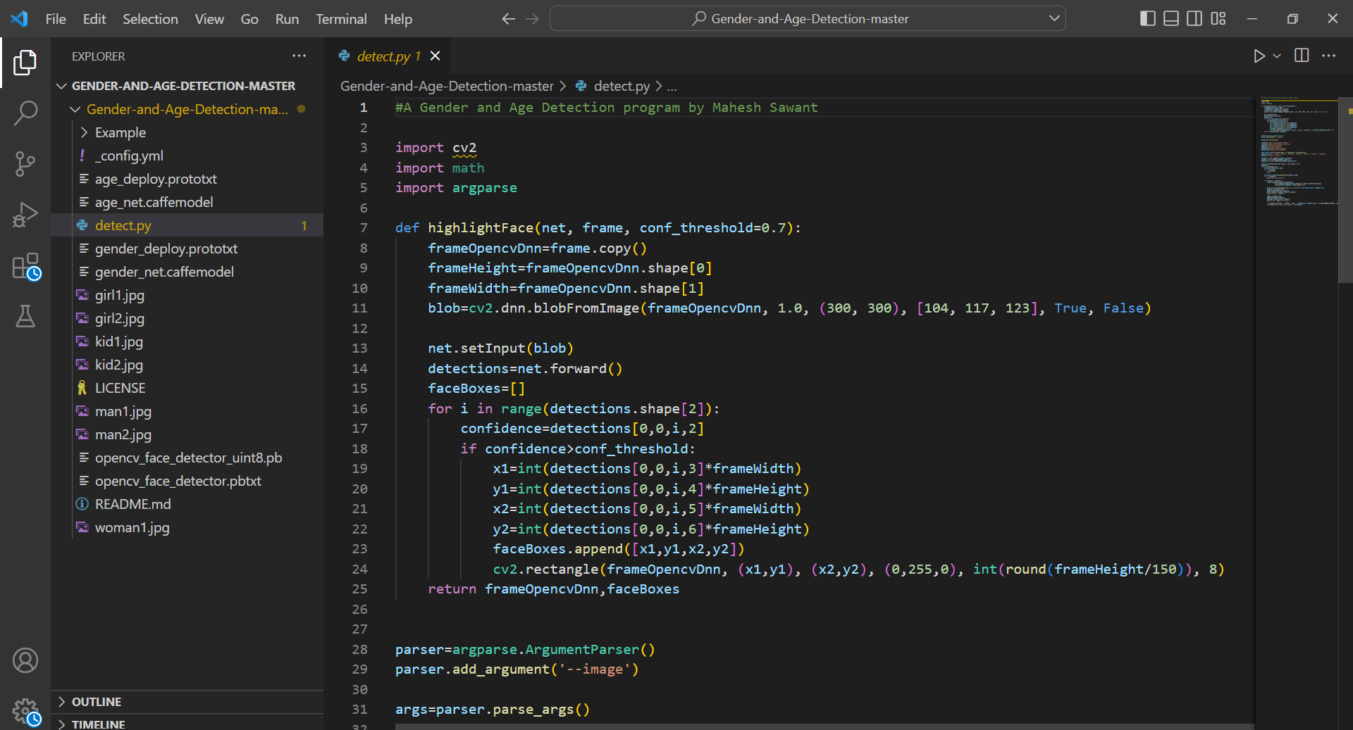
PROOF OF CONCEPT/PROTOTYPE DETAILS

Slide 7
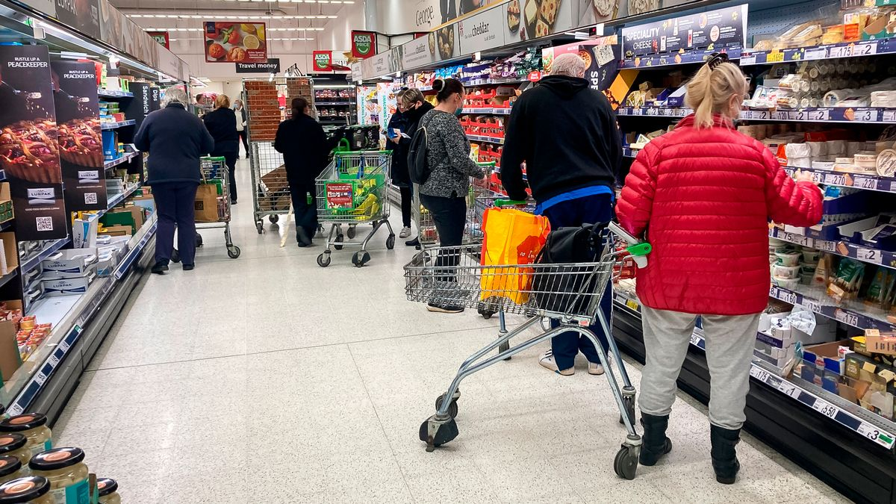
VALUE PROPOSITION
The proposed deeply learned classifiers for age group and gender classification of unfiltered real-life face images.
Age detection and gender detection have many different uses. For example, in-store and front-of-shop age detection and gender detection are very effective even in retail businesses. By using these technologies, businesses can identify customer segments, change or develop marketing strategies according to this segment, and change their product range.

Slide 8
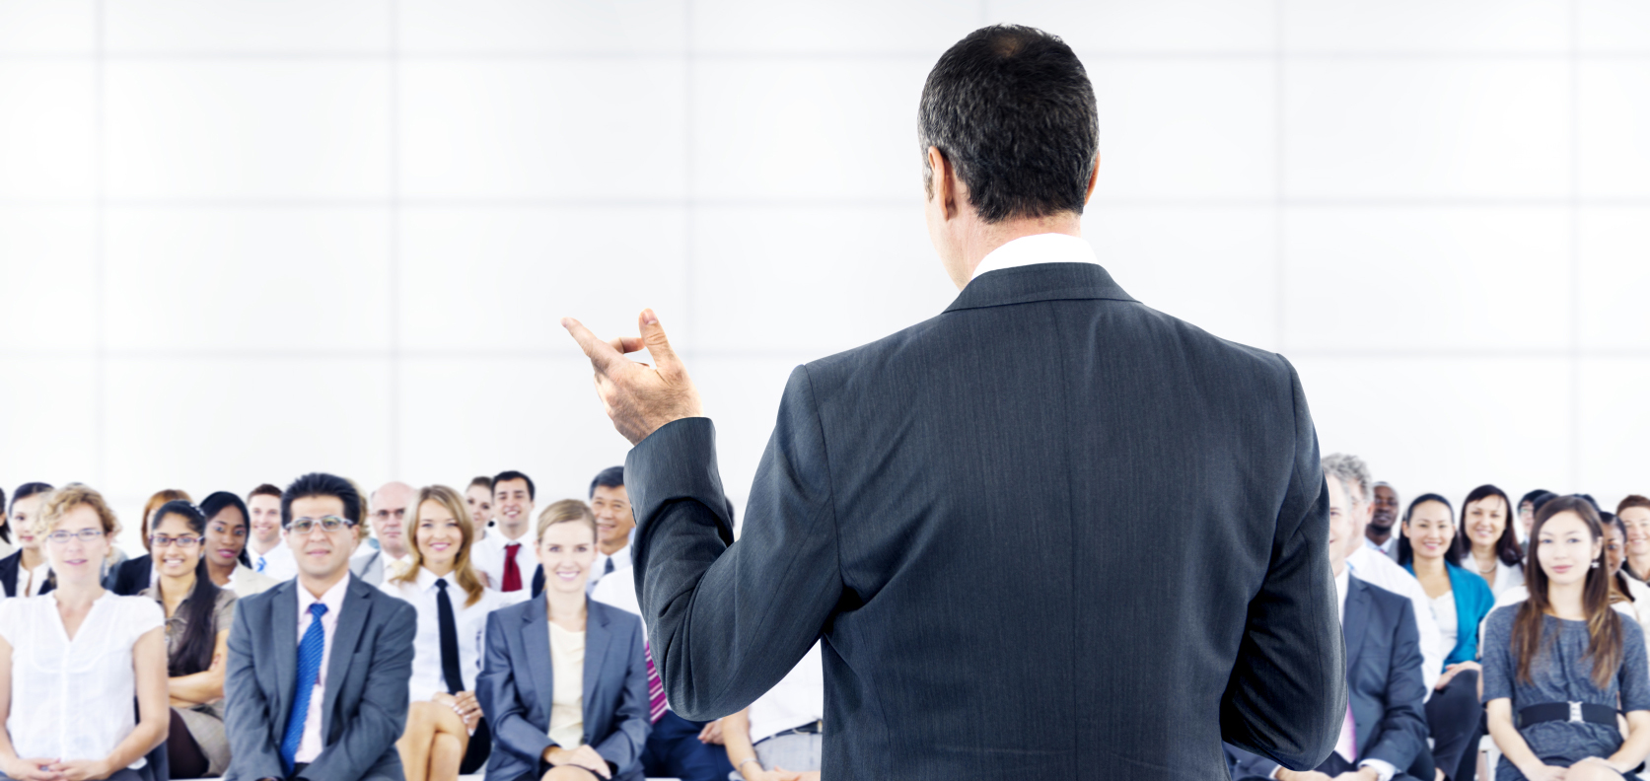
VALUE PROPOSITION
For example, some software can detect the age range of users passing by a business and suggest advertisements that will affect this age range. It is possible to use age detection and gender detection not only for sales purposes but also for security purposes because algorithms can make more accurate age and gender determinations than humans.

Slide 9
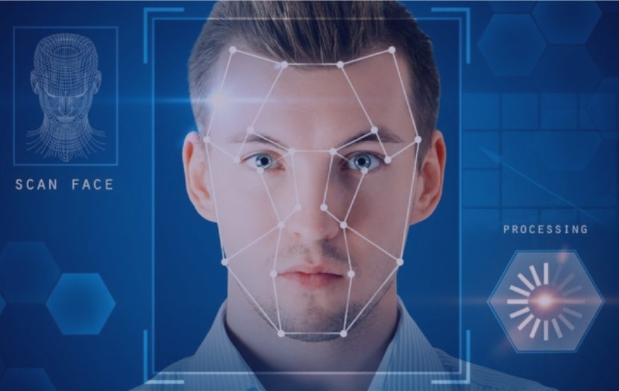
COMPETITION
Age and gender detection is essential for authentication, human-computer interaction, behavior analysis, product recommendation based on user preferences, and many other areas.
Many companies needed age and gender data capture, but few solutions were available. Significant developments have been made in the past few years to meet this need.
Understand what products and services different customer groups want and can afford.
Target marketing campaigns more precisely and thus reduce the cost per lead or sale.
Identify how society is changing and how they need to adapt.

Slide 10
THANK YOU

